Slide 1


DYNAMIC PROGRAMMING
&
GREEDY ALGORITHM
TEAM R
202235045 박선인
202135814 이정균
202235070 안수빈
20233445 김지해

Slide 2

CONTENTS
1.
1.
1.
1
2
3
- FIRST ISSUE
SOLUTION CODES FOR TWO DIFFERENT ALGORITHMS
COMPARISON OF TWO ALGORITHMS
- SECOND ISSUE
SOLUTION CODES FOR TWO DIFFERENT ALGORITHMS
COMPARISON OF TWO ALGORITHMS
CONSLUSION OF THE COMPARISON BETWEEN THE TWO ALGORITHMS
- REASON FOR CHOOSING A TOPIC
- EXPLANATION OF THE GREEDY ALGORITHM
- EXPLANATION OF THE DYNAMIC PROGRAMMING
02

Slide 3

1
REASON FOR CHOOSING A TOPIC
1.
We don't know which algorithm to solve the problem, so we substitute various algorithms to find out which algorithm is more efficient.
Compare the differences between the two algorithms

Slide 4
1
EXPLANATION OF THE GREEDY ALGORITHM
1.
Definition
Greedy algorithm
Algorithms that make a choice that you think is optimal at every moment and reach the final answer
An algorithm that repeats the optimal selection for each selection and attempts to obtain the optimal solution when viewed as a whole.

Slide 5
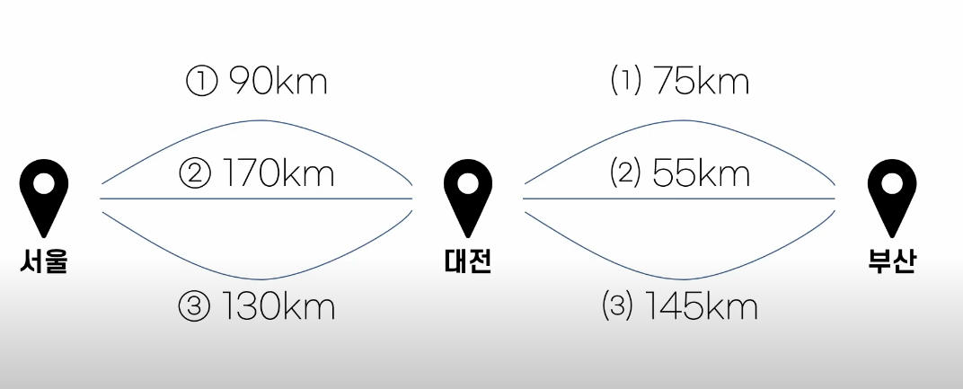
1
EXPLANATION OF THE GREEDY ALGORITHM
1.
condition
Greedy Choice Property
Optimal Substructure

Slide 6
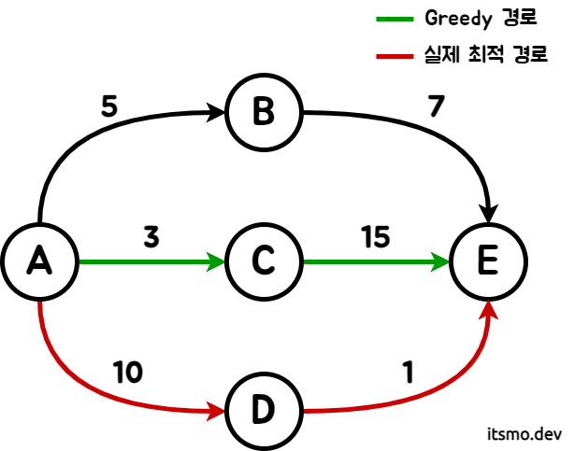
1
If greedy algorithm is not established
1.
Not established
Greedy algorithm
A->c->E
Actcual node
A->d->E

Slide 7
1
EXPLANATION OF THE GREEDY ALGORITHM
Pros
Because we choose the best choice at each step, it’s efficient about time
1.
1.
Cons
- We need some condition to use greedy algorithm

Slide 8
1
EXPLANATION OF THE DYNAMIC PROGRAMMING
1.
Definition
Dynamic Programming
One of the problem-solving approach algorithm which is divide one big and complicate problem into small several problems
Save the result of small problems and reuse it whenever we need it to reduce calculating time

Slide 9
1
EXPLANATION OF THE DYNAMIC PROGRAMMING
1.
condition
Overlapping Subproblems
Big problem should be divided into small problems
Optimal Substructure
Solution of small problem should be same solution at big problems

Slide 10
1
EXPLANATION OF THE DYNAMIC PROGRAMMING
1.
How to working
Bottom-Up (Tabulation)
It is a method of solving the entire problem by solving the small part problem in turn. To do this, repeat sentences are used to solve partial problems repeatedly, and the results are stored in an array, etc.
Top-Down (Memoization)
A way to solve a big problem by dividing it into small parts

Slide 11
1
EXPLANATION OF THE DYNAMIC PROGRAMMING
Pros
We can reduce a calculating time. Because we reuse result of small problem, the more and better the small problems, we can reduce more time
1.
1.
Cons
We need some condition to use greedy algorithm
Because we use memory to save result, memory usage get bigger

Slide 12
2.1
BAEKJOON 14916
1.
Chunhyang works at the convenience store counter.
The customer asks for change only in the 2-won and 5-won coins. There are infinitely many 2-won coins and 5-won coins. They must be traced back to the minimum number of coins. If the change is n, write a program that tells you how many coins there are at least.
For example, if the change is 15 won, you have to give three 5-won coins, if the change is 14 won, two 5-won coins and two 2-won coins, a total of four 5-won coins, and if the change is 13 won, you have to give a total of five 5-won coins and four 2-won coins to minimize the number of coins.
https://www.acmicpc.net/problem/14916

Slide 13
2
2.1
SOLUTION CODES FOR TWO DIFFERENT ALGORITHMS
1.
1.
GREEDY
DP
Read data from input.txt
Read data from input.txt
Initialize Count
Count = 0
Allocate dp[]
int* dp =
(int*)calloc(n + 1, sizeof(int))
Check if n % 5 == 0
yes
no
Initialize dp[]
dp[] = -1
dp[2] = 1
dp[4] = 2
dp[5] = 1
Count += n //5
n = 0
N -= 2
Count += 1
End
Check If n < 0
yes
no
Record all 에
dp[i] = min(dp[I – 2], dp[I – 5])
n = -1
(fail)
End

Slide 14
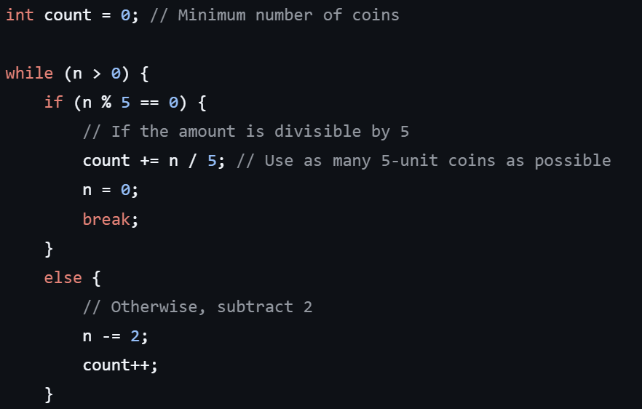
2
2.1
SOLUTION CODES FOR TWO DIFFERENT ALGORITHMS
1.
GREEDY
Highlight

Slide 15
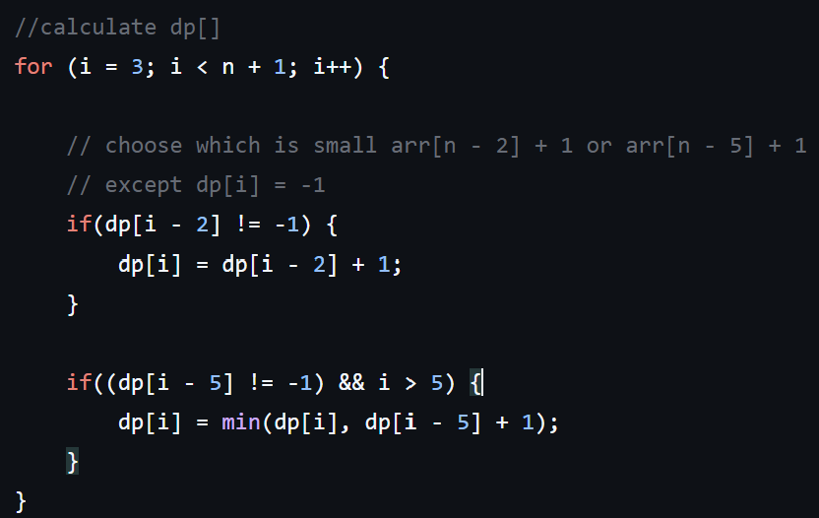
2
2.1
SOLUTION CODES FOR TWO DIFFERENT ALGORITHMS
1.
Highlight
DP

Slide 16
2
2.1
COMPARISON OF TWO ALGORITHMS
1.
1.
GREEDY
DP
Use 5 won first
:
check if 5 won is best option using n%5 == 0
Reduce 소 number of coin by using as many as possible cash
After we use 5 won, use 2 won to reduce left cash
Record the each cash solution in dp[]
:
Set the result of 1 ~ 5 won and record it in dp[]
Use it to get solution when the cash is more than 5 won

Slide 17
2
2.2
BAEKJOON 1931
1.
There is a single conference room and I want to create a meeting room usage table for the N meetings that I want to use.
For each conference I, let's find the maximum number of conferences that can be used without overlapping each conference.
However, once the conference begins, it cannot be interrupted in the middle, and the next conference can start at the same time as one conference ends. The start and end times of the conference may be the same. In this case, you can think of it as ending as soon as it starts.
https://www.acmicpc.net/problem/1931
05

Slide 18
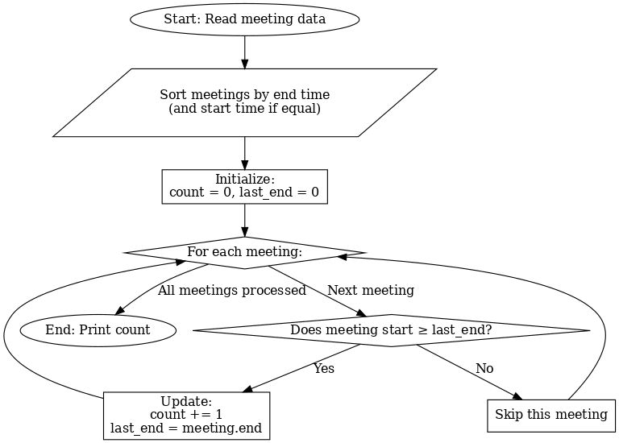
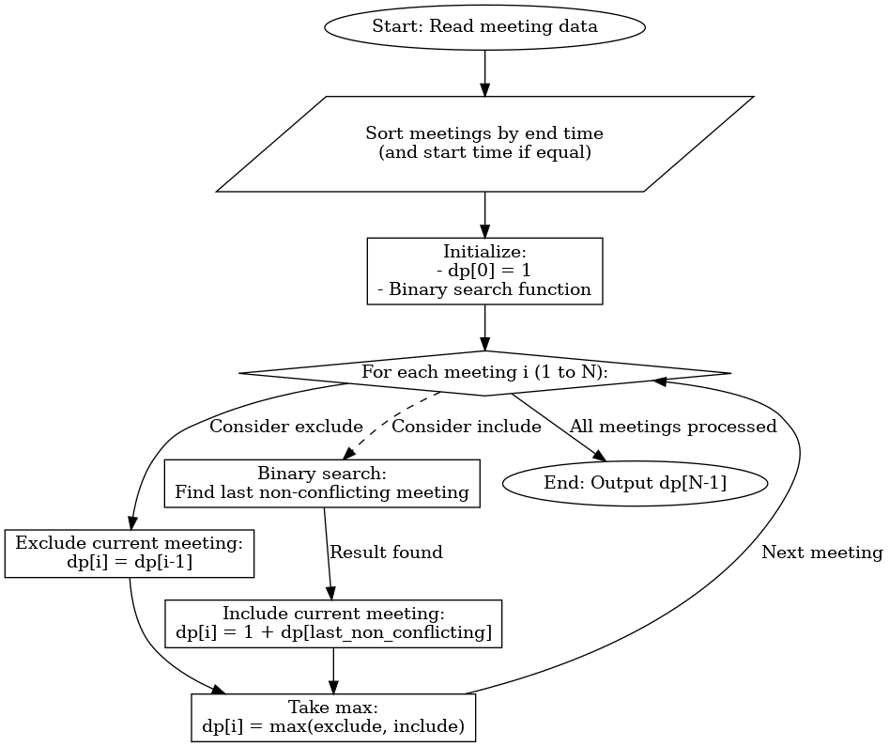
2
2.2
SOLUTION CODES FOR TWO DIFFERENT ALGORITHMS
1.
1.
GREEDY
DP

Slide 19
2
2.2
SOLUTION CODES FOR TWO DIFFERENT ALGORITHMS
GREEDY
DP
1.
1.
// Sort meetings by end time
qsort(meetings, n, sizeof(Meeting), compare);
// Loop through each meeting
for (int i = 0; i < n; i++) {
if (meetings[i].start >= last_end) { // Check for non-overlapping
count++; // Increment selected meeting count
last_end = meetings[i].end; // Update the end time
}
}
// Print the maximum number of meetings
printf("%d\n", count);
}
// Sort meetings by end time
qsort(meetings, N, sizeof(Meeting), compare);
// Initialize DP array
dp[0] = 1; // First meeting can always be selected
// Iterate through each meeting
for (int i = 1; i < N; i++) {
int exclude = dp[i - 1]; // Case 1: Exclude current meeting
// Case 2: Include current meeting
int include = 1;
int lastNonConflicting = binarySearch(meetings, dp, i);
if (lastNonConflicting != -1) {
include += dp[lastNonConflicting];
}
// Take the maximum of exclude and include
dp[i] = (exclude > include) ? exclude : include;
}
// Output the result
printf("Result: %d\n", dp[N - 1]);

Slide 20
2
2.2
COMPARISON OF TWO ALGORITHMS
1.
Steps:
1. Sort meetings by their end time (and by start time if end times are the same).
2. Select meetings sequentially, ensuring the start time of the current meeting is after the previous meeting's end time.
3. Update the end time for the next comparison.
Time Complexity:
𝑂(𝑁log⁡𝑁)for sorting and 𝑂(𝑁) for selection,
resulting in 𝑂(𝑁log⁡𝑁).
Features:
Optimality is guaranteed due to the problem's greedy choice property and optimal substructure.
Simple, efficient, and guarantees the correct solution.
1.
GREEDY
DP
Steps:
Define 𝑑𝑝[𝑖] as the maximum number of meetings
that can be selected from the first 𝑖 meetings.
2. Use the recurrence relation 𝑑𝑝[𝑖]=max⁡(𝑑𝑝[𝑖−1],𝑑𝑝[𝑘]+1) , where 𝑘 is the index of the last non-overlapping meeting.
3. Compute 𝑑𝑝[𝑖] for all 𝑖.
Time Complexity:
𝑂(𝑁^2) due to overlap checks
(or 𝑂(𝑁log⁡𝑁)with binary search).
Features:
Considers all possible combinations, making it slower and more memory-intensive than the greedy approach.
The greedy algorithm is better suited for this problem due to its simplicity and efficiency, as the problem satisfies both the greedy choice property and optimal substructure. DP is unnecessary and overcomplicated in this case.

Slide 21
3
CONSLUSION OF THE COMPARISON BETWEEN THE TWO ALGORITHMS
1.
When Greedy is Efficient:
1. Simple optimal substructure: Local optimal choices directly lead to the global optimal solution.
2. Sequential problem-solving: Decisions are final and don’t require backtracking.
3. Intuitive problem-solving: No complex state tracking or redundant calculations are needed.
1.
When DP is Efficient:
1. Overlapping subproblems: The same calculations are repeated multiple times.
2. Complex optimal substructure: Exploring all possibilities is necessary to find the best solution.
3. Dependence on past states: Current decisions rely on results from multiple previous states.

Slide 22
2
2.2
Github
1.
https://github.com/flying-adventure/algorithm_termproject
https://www.acmicpc.net/problem/1931
05

Slide 23
2
2.2
Reference
1.
https://www.youtube.com/watch?v=_IZuE7NIeW4
https://www.itsmo.dev/greedy-algorithm/
https://velog.io/@boyeon_jeong/%EB%8F%99%EC%A0%81%EA%B3%84%ED%9A%8D%EB%B2%95Dynamic-Programming
https://m.blog.naver.com/PostView.naver?blogId=jjyoung5959&logNo=223254857350&searchKeyword=%EC%9D%B4%EA%B2%83%EC%9D%B4%20%EC%BD%94%EB%94%A9%20%ED%85%8C%EC%8A%A4%ED%8A%B8%EB%8B%A4
https://velog.io/@soyeon207/%EC%95%8C%EA%B3%A0%EB%A6%AC%EC%A6%98-%EB%8F%99%EC%A0%81-%EA%B3%84%ED%9A%8D%EB%B2%95-Dynamic-Programming-DP
https://ai-sinq.tistory.com/entry/%EB%8F%99%EC%A0%81-%ED%94%84%EB%A1%9C%EA%B7%B8%EB%9E%98%EB%B0%8D-Dynamic-Programming-DP
https://skmouse.tistory.com/entry/%ED%83%90%EC%9A%95Greedy%EC%95%8C%EA%B3%A0%EB%A6%AC%EC%A6%98%EB%8F%99%EC%A0%81Dynamic%EA%B3%84%ED%9A%8D%EB%B2%95
https://www.acmicpc.net/problem/1931
05

Slide 24
THANK YOU

